Slide 1


Specialize Parking Oriented Technology (S.P.O.T.) Senior Design Project June 4, 2018
Team Members:
Ramsey Ghanaim
Jonathan Lam
Mario Cabrera
Travis Rogers

Slide 2
Problem Statement
Our goals for SPOT is to create a modern Parking Management System that is:
Low powered for each parking unit
Intuitive and convenient for users
Simple to use for parking administrators
Track lot usage and manage user credentials
Our objective is to improve upon the current UCSC parking system by including:
An easier way to find parking via mobile app
An automated way to verify/pay for parking with or without permits
An administrator tracking system
Real-time parking status updates

Slide 3
Project Requirements
Hardware
SoftwarE
Spot unit
Proximity sensor, Bluetooth, and LEDs to communicate with users
Wifi interface to connect with gateway and system
Efficient
Easy to use for users
Scalable
Low power
Scalable
Allow software to be used in a variety of different parking sizes.
Support 10 simultaneous sensor connections
Easy to Use
Intuitive user experience for mobile app
Users can monitor parking lot statuses
Simple administrative website
3

Slide 4
Our Approach
What technologies do we use?
Google Cloud Platform’s App Engine
Scalable Server
Ti Simplelink 3220S
Low power microcontroller
Built-in Wifi
HC-SR04 Ultrasonic Sensor
Low power and low cost sensor
Adafruit Bluefruit LE Bluetooth Beacon
Low power and easy to program
User identifies their spot with a Mobile App
Raspberry Pi
Gateway between Sensors and App Engine (Scalable and
minimizes connections to the App Engine)
Powerful enough to use threads, but low enough to consume less power than a PC
Android Studio
Mobile App
Administrator Website
Admins can manage parking and user accounts
4

Slide 5
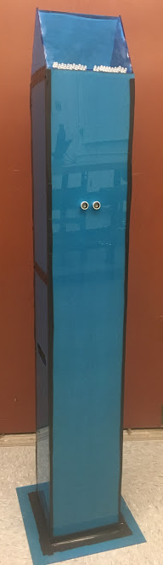
S.P.O.T. Sensor
Power management
Body design
Acrylic design is cheap and sturdy
4 ft tall so users can see LEDs from car
Sensor 30" from the ground to detect most cars
Ultrasonic sensor to detect car
Assume a car after 5 seconds
~ 3ft range for sensor
LEDs to communicate with user
Colors indicate spot status
RGB: illegal, closed, busy
Bluetooth beacon to connect to user's app
Turns on when spot is busy only
Wifi to connect to gateway
Network socket messages for spot status
Heartbeat messages and event messages

Slide 6
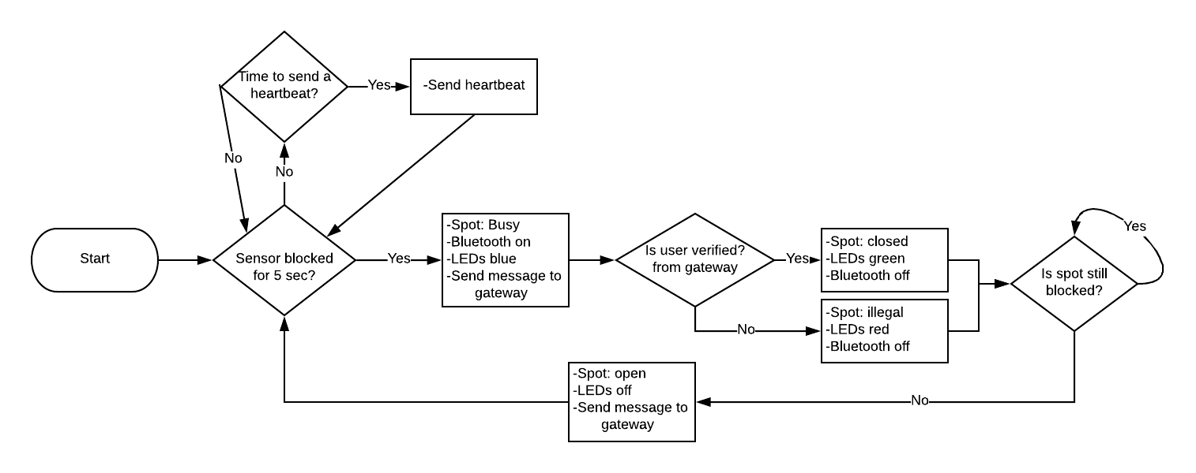
Sensor Flow Diagram

Slide 7
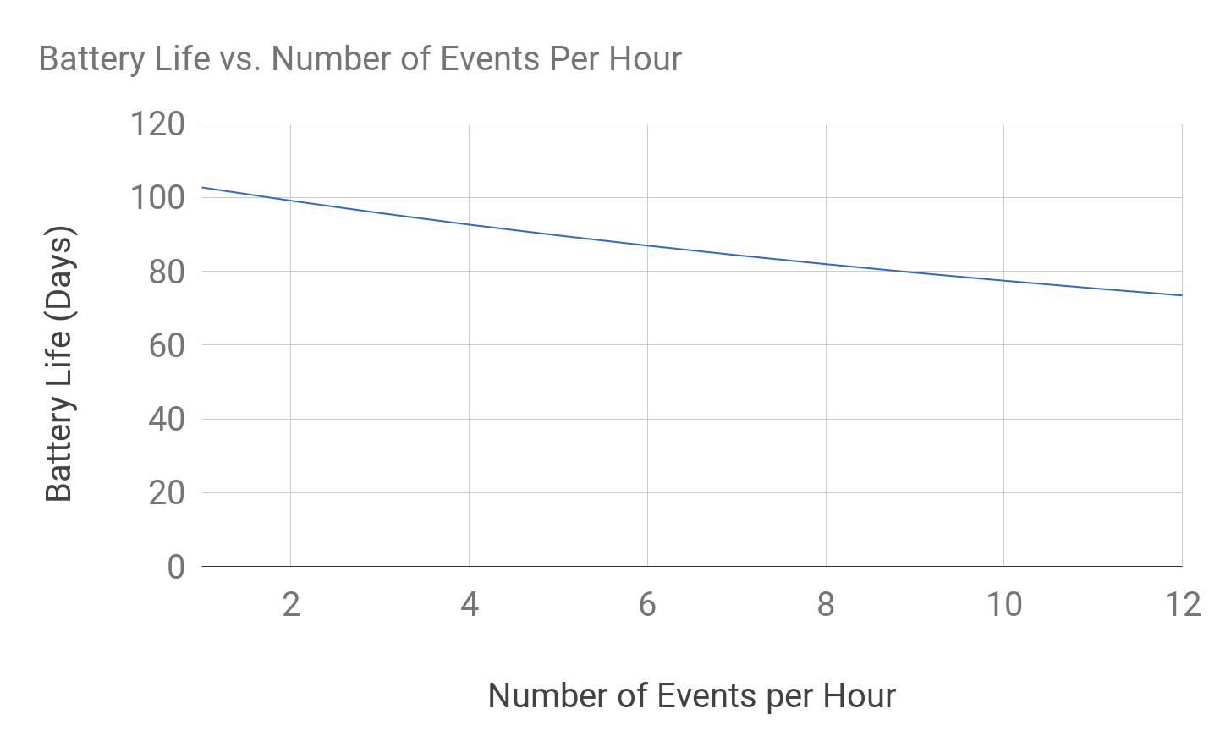
Power Consumption
Assumptions:
13 hour workday
Microcontroller on for 1 second, followed by 3 seconds of sleep
30 second average user verification where the MC/Bluetooth Beacon must be on
Unit draws between 15 to 350 mA of current depending on activity
3,000 mAh battery (2 sets of 3 AA batteries in parallel)

Slide 8
Gateway Implementation
Forward status's from SPOT sensor to the App Engine
Forward LED statuses from App Engine to SPOT sensors
HTTPS messages to the App Engine are formatted as JSON objects
Reliability
Make messages re-send if not sent properly
Have Sensors consistently “check in” with the Gateway to keep track of broken SPOT sensors
Start
accept() Wait and accept incoming connections
Max threads in use?
Pthread_join() Wait for one thread to complete
Yes
Send to App Engine
Forward App Engine response to SPOT Sensor
checkIn =2
No
Determine Message type
pthreadCreate() Wait and accept incoming connections
checkIn = 1
Log spot check in
msg =“timer”
Make sure all sensors checked in

Slide 9
Google App Engine - Web Application
Connectivity between system components
Purpose:
Manages status changes for spots
Updates SQL database
Verifies users through the mobile app
Payments
Permit Enforcement
Tracks transaction and spot occupation history

Slide 10
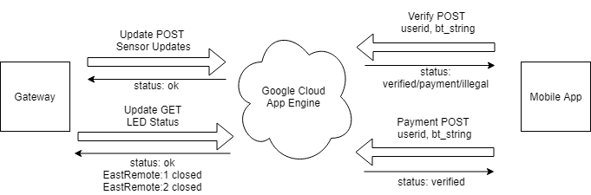
Google App Engine - Implementation
Information sent through HTTP GET/POST messages
Data encoded in JSON objects
Gateway, Mobile App, Website
App Engine forwards messages to custom HTTP handlers
Hosts admin website and provides functionality
Verify POST
User Info
Update POST
Sensor Updates
Update GET
LED Status
Payment POST
User Info

Slide 11
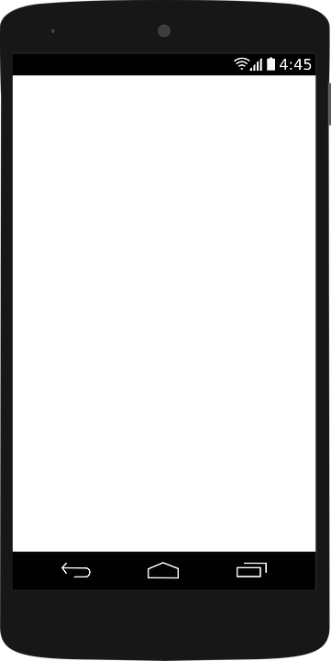
Mobile App - User Interface and Layout
Activities
Each activity contains its own data and functions
Usually isolated from other activities in terms of functionality
Currently have one specific activity to hold core processes within the app (HTTPS and Bluetooth)
Fragments
An extension of an activity
Behaves similarly to an activity, also isolated
We utilize fragments to provide app navigation while still maintaining HTTPS and Bluetooth functionality
Main Activity
Fragment 1
Fragment 2

Slide 12
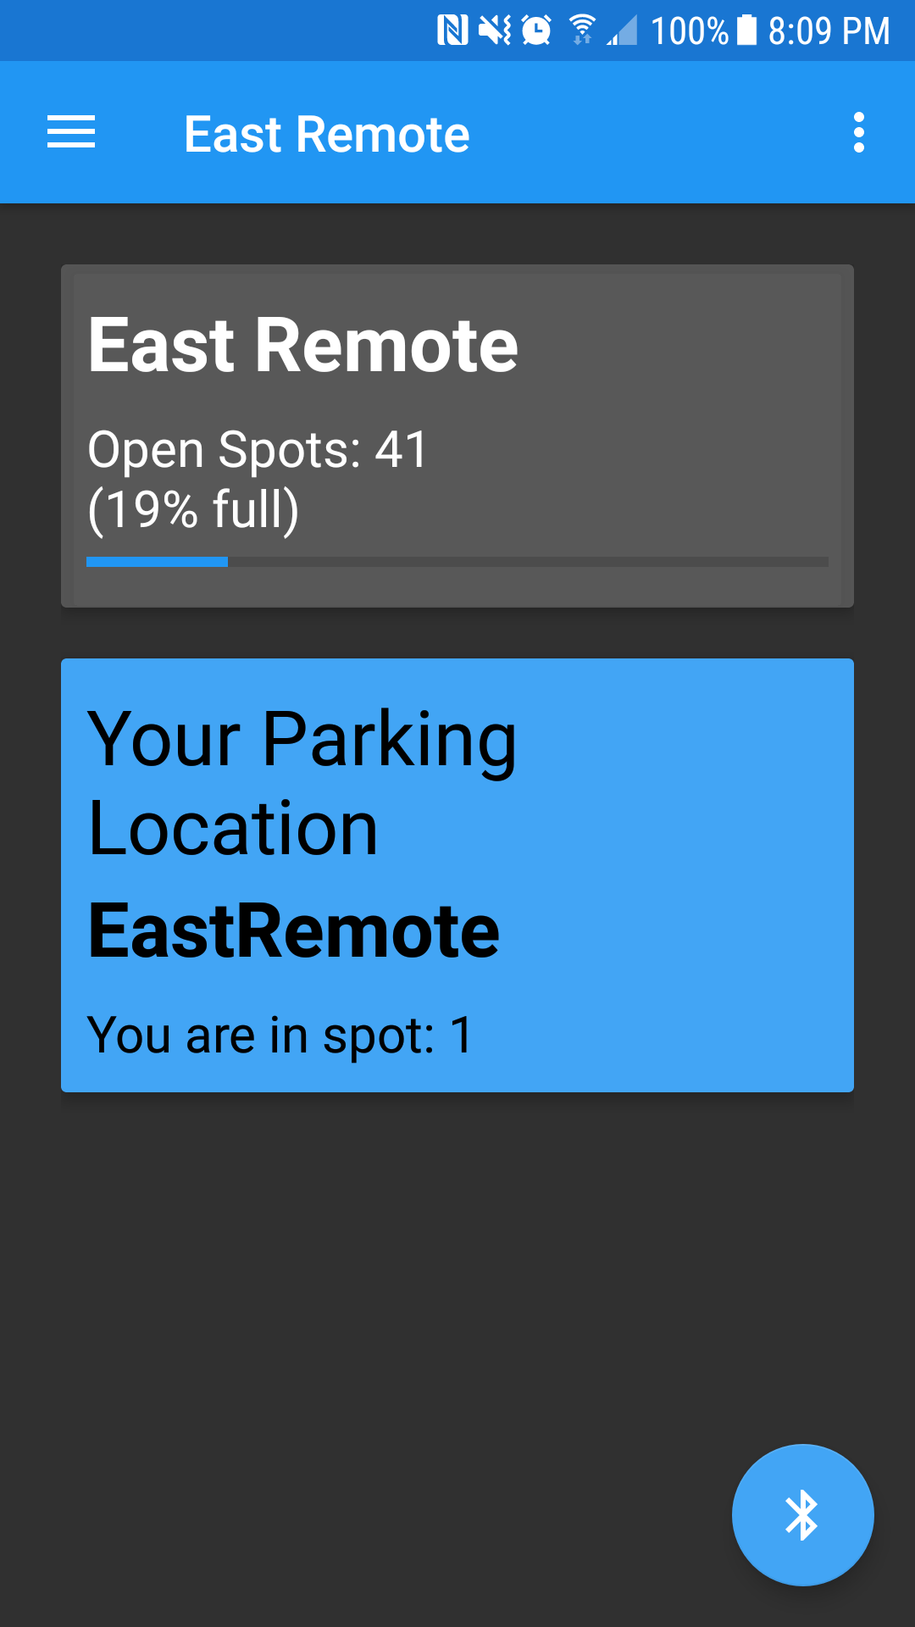
Mobile App - Main Activity
HTTPS POST and GET requests
Utilize the android Volley library rather than the standard method
Using the volley is a faster protocol with many requests being called at once
Handles all communication between the database and the mobile app
Bluetooth Scanner
Utilize the standard Bluetooth Adaptor library
Reads iBeacon formatted Bluetooth low-energy devices
Can read multiple beacons at once
Navigation
Drawer
Log Out
Scan for
Beacons

Slide 13
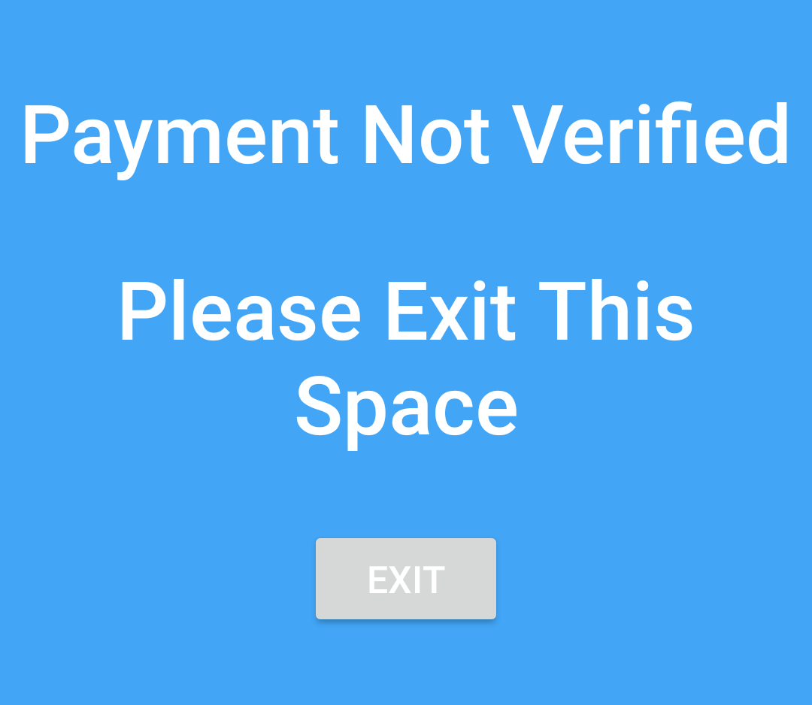
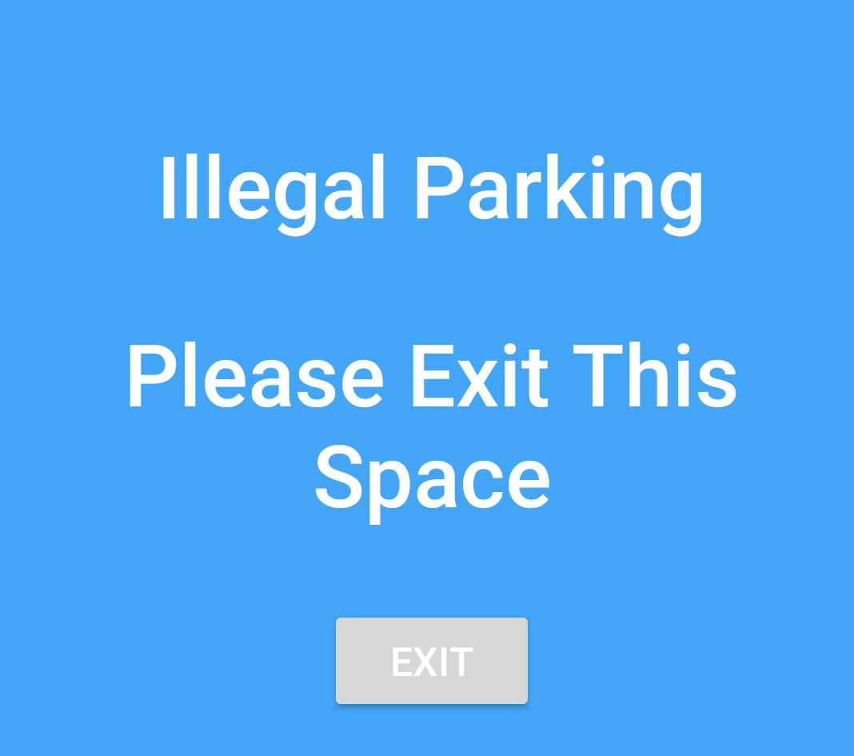
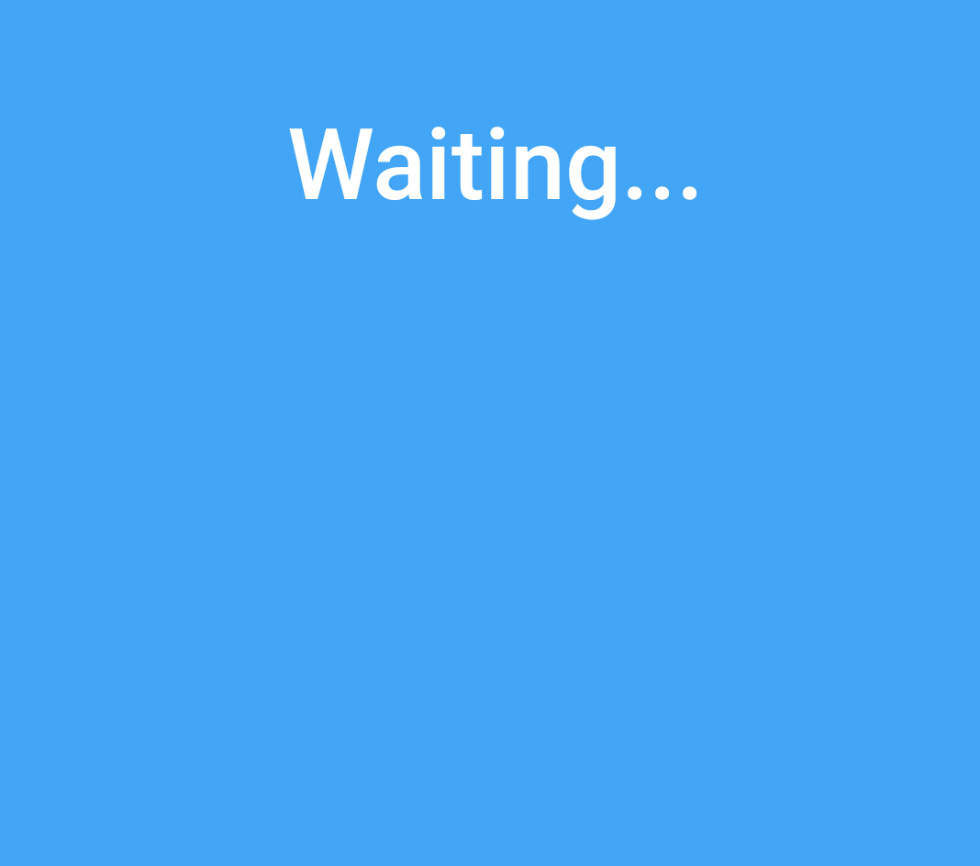
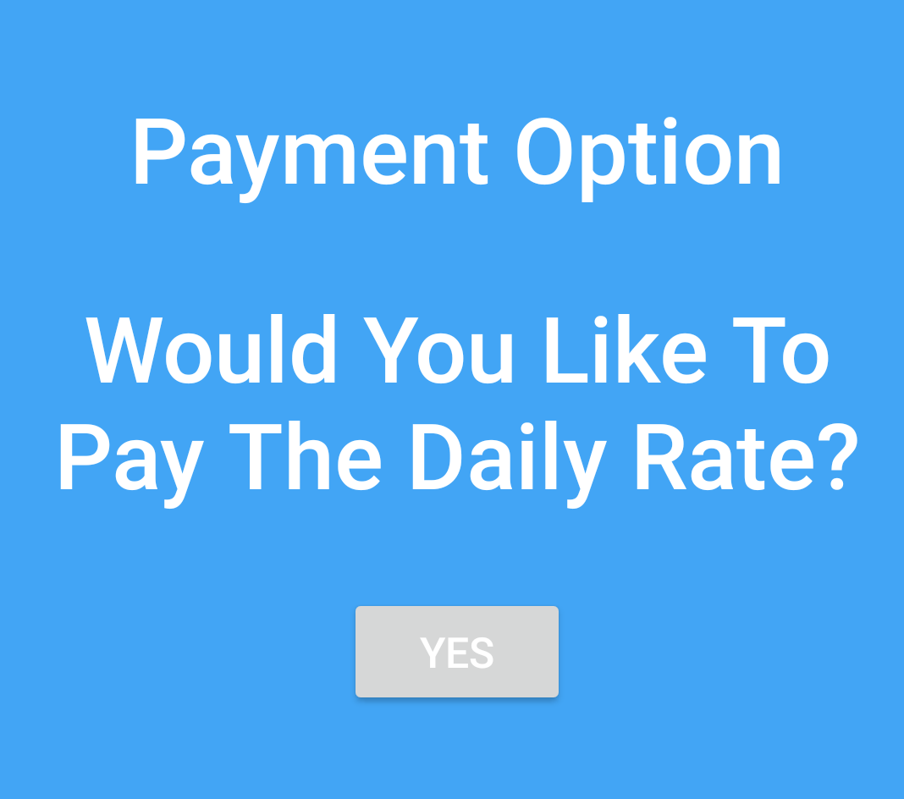
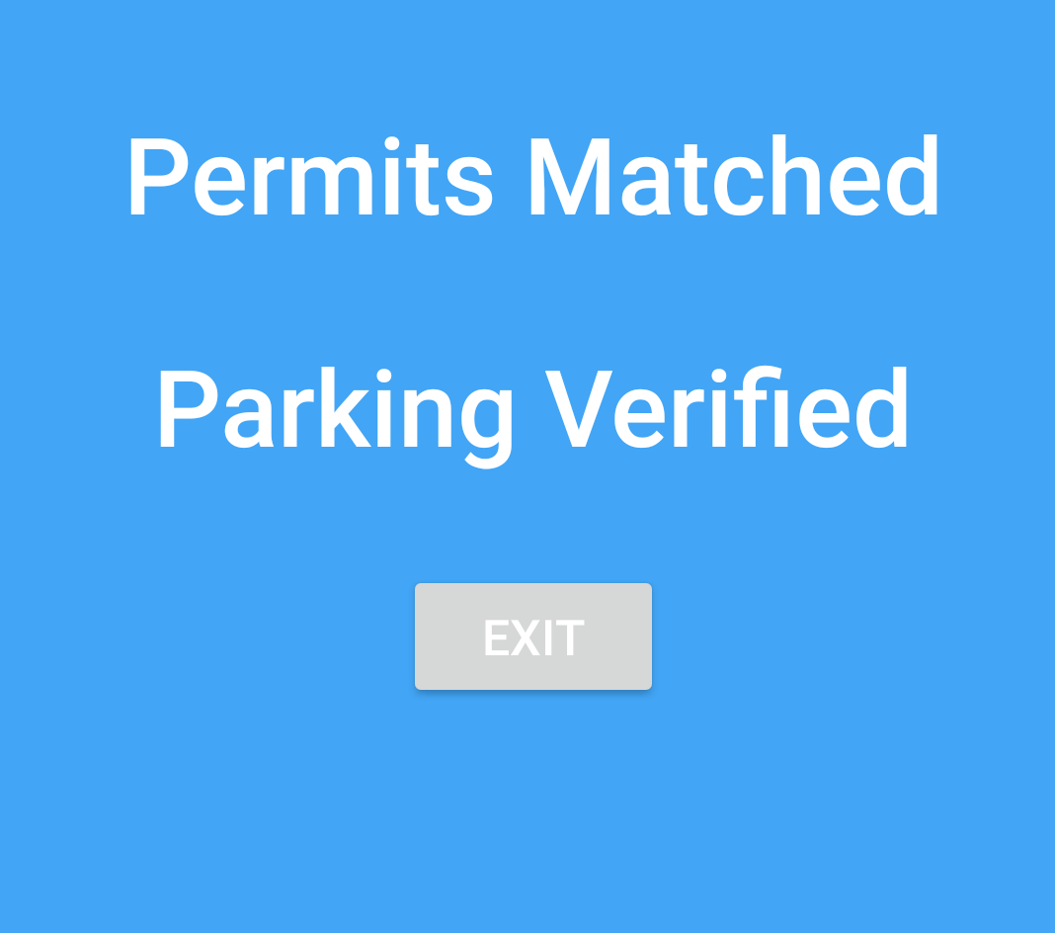
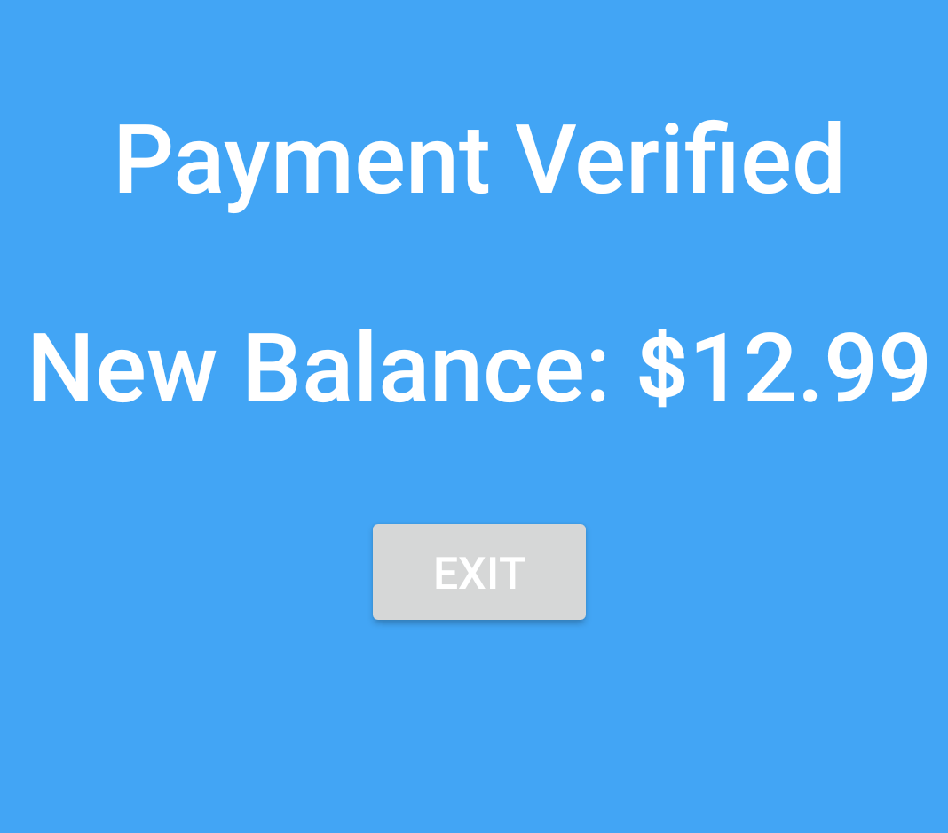
Mobile App - Permit Verification/Payment

Slide 14
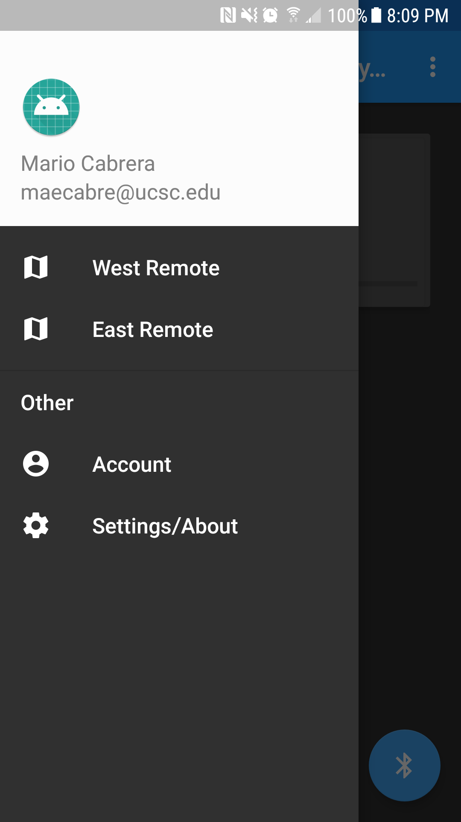
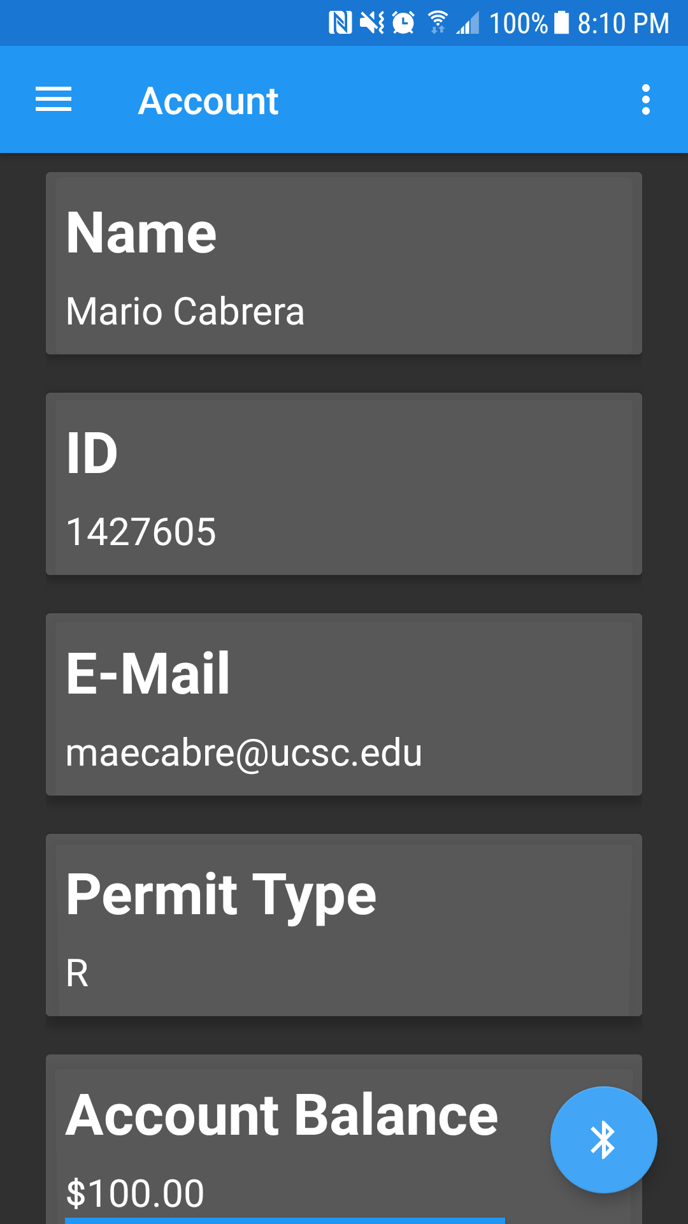
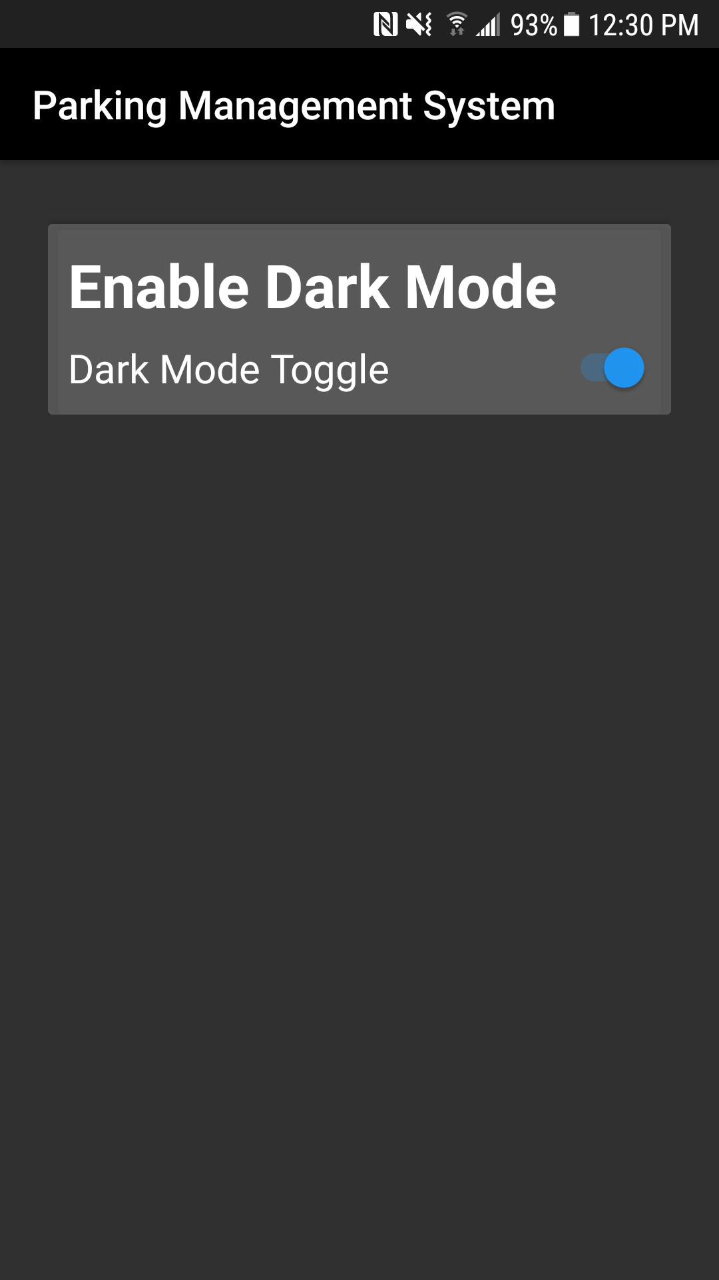
Mobile App - User Interface and Layout
Navigation Drawer
Account Fragment
Settings Activity

Slide 15
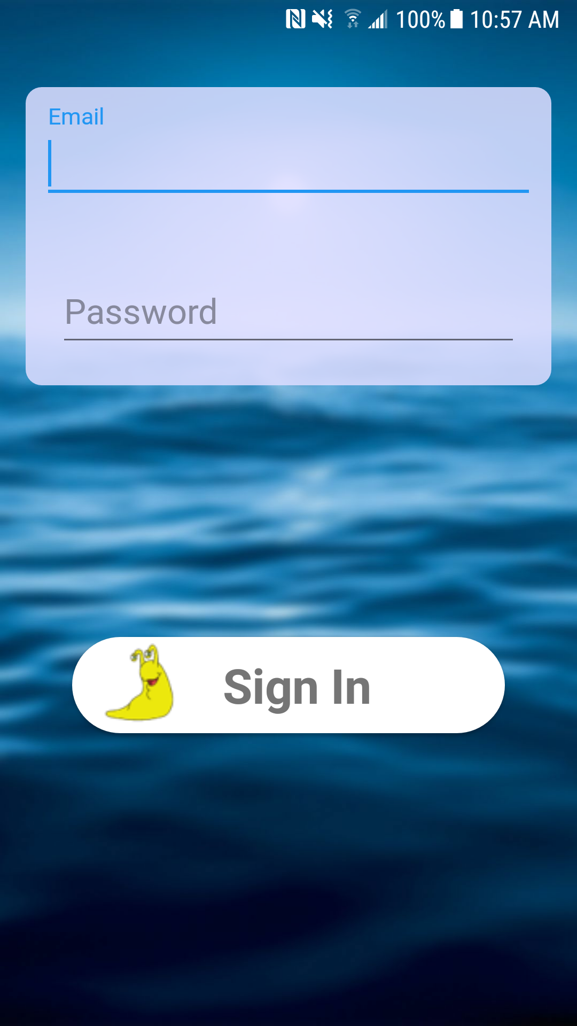
Mobile App - Login Activity
POST requests
sendLoginVerify() calls to .../login
Checks user credentials with the Google Database
reqeustAccountInfo() calls to .../mobileInfo
Pulls all user info after login is successful
saveInfo()
Saves information to sharedPreferences
Information is accessed solely through sharedPreferences
Isolated from the rest of the app

Slide 16
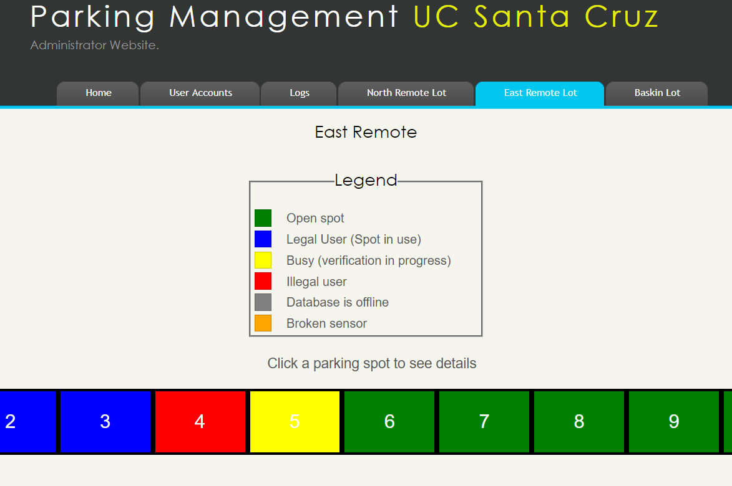
Administrator Website
Live view of Parking Spaces
Clicking on a space shows more details (User credentials)

Slide 17
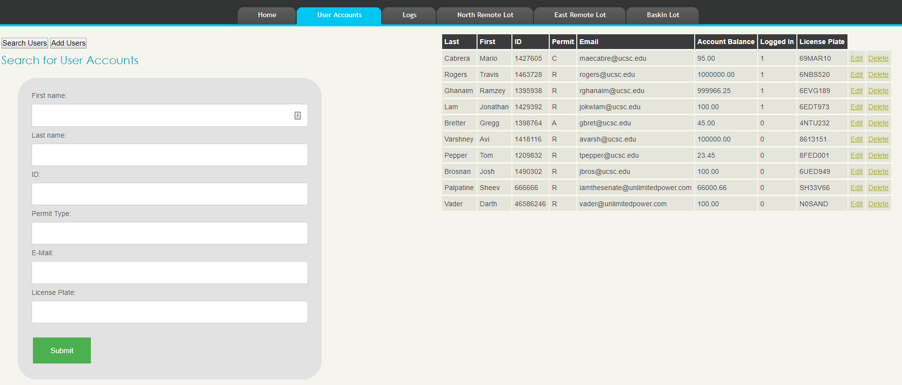
Administrator Website
Edit Account Information

Slide 18
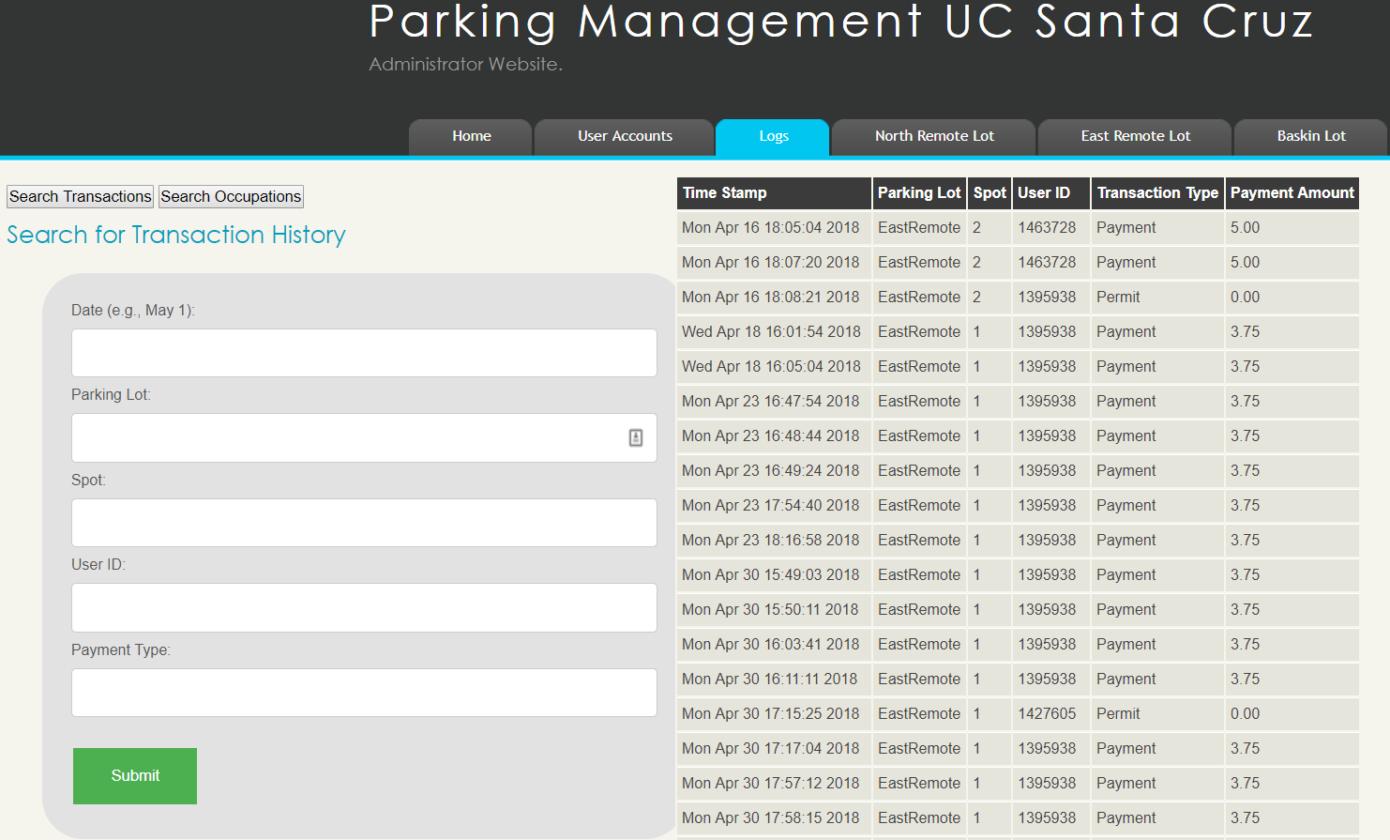
Administrator Website
View transaction and occupation history

Slide 19
Spring Quarter Results
Everything is functional!
What could be improved on?
Implement solar panels to further increase battery life.
Camera for license plate recognition
Graph Analytic Data
Google Pay and Apple Pay support

